Slide 1
SECURITY AND SURVEILLANCE DRONE
Project Guide : Mr. Abhijit Dongaonkar
Project Members :
Mihir Panchal (T118)
Sarid Qureshi (T154)
Prinkal Doshi (T107)
Tanay Desai (T137)
Arshkumar Sakaria (T127)

Slide 2
Introduction
Give brief introduction and history of using drones
What makes drone project a final year project

Slide 3
Problem Statement
Give a use case (eg beach or x)
Take a beach photo x and explain with photo
Then fade the photo and give another use case (with photo) explained in intro of arsh’s police use of security for finding criminals via face recognition

Slide 4
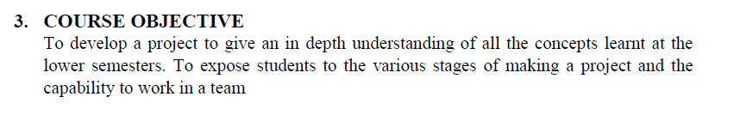
Objective of #Project
1.Engineering Mathematics
2.Communication Skills
1.Basic Electronics
2/Fundamentals of Computing System
1.Applied Mathematics
3.Website Designing
3.Programming in C++
3.Data Structures
3.Data Communication and Networking
2.Multimedia and Animation
3.Emerging Trends in IT
1.Internet Security
3.Open Source Technology
2.Database Management System
3.Software Enginnering
3.Programming in Python
3.Object Oriented Modelling and Design
2.Human Computer Interface
2.Summer Implant
3.Network Administration
3.Machine Learning
3.IOT and Applications
3.Cloud Application Development
Notes:
1 – Less useful – Yellow
2 – Moderate useful – Orange
3 – Highly useful - red

Slide 5
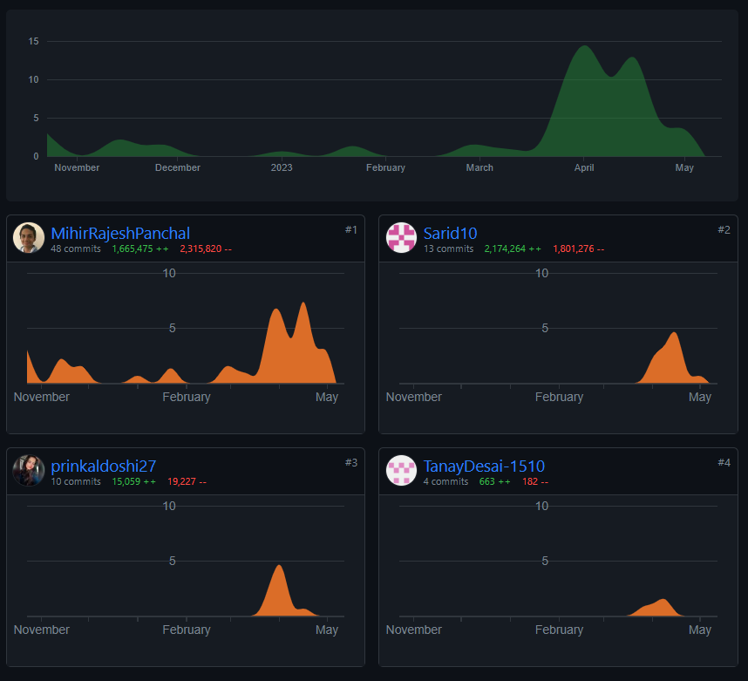
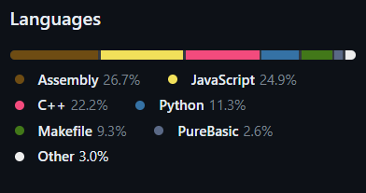
Project Workflow with Software Engineering
SDLC Model used in agile (Have diagram ) then fade
Explain tools –
Github – version control (show
Tech stack explaination – Frontend and Backend

Slide 6
Web Application STAMP
1. Pages Hierarchy flowchart
2. Zoom in into each hierarchy cell and then show output of each cell

Slide 7
Face Recognition
Working Diagram - Fade out
Steps to perform

Slide 8
Face Recognition Output
Two video players one after another
1. How to do the process
2. Output

Slide 9
Face Recognition Performance
Speed vs face train statistical graph
Add big numbers in text

Slide 10
Object Detection
Working Diagram - Fade out
Steps to perform

Slide 11
Object Detection Output
Two video players one after another
1. How to do the process
2. Output

Slide 12
Object Detection Performance
Speed vs length of video train statistical graph
Add big numbers in text

Slide 13
Hand Gesture Recognition
Working Diagram - Fade out
Steps to perform

Slide 14
Hand Gesture Recognition Output
Two video players one after another
1. How to do the process
2. Output

Slide 15
Hand Gesture Recognition Performance
Speed vs hand train statistical graph
Add big numbers in text

Slide 16
Overall 3 models Performance
Comparative graphs

Slide 17
Drone Programming
Drone picture with small piece of code

Slide 18
Pluto X API (MSP Protocol)
Explain connection establish
Packet delivery
Packet decryption
Response
Working Diagram
Output Video

Slide 19
STAMP Support
Explain Use case of Beach
Show features
Control done remote
Chat
Dronegpt
Output

Slide 20
Cloud Architecture
Explain coupling and cohesion between components of project with cloud
Cloud architecture diagram
Explain s3, sns, dynamodb

Slide 21
Gallery
Show all achievements
Share experience to show our connectivity as group with project
Thoda senti karna hai

Slide 22
Future Scope
Take that sentiness to ultimate level by convincing external to believe we are connected to this project and will continue
Will increase its performance by increasing payload and features

Slide 23
Conclusion / Any questions

